Slide 1
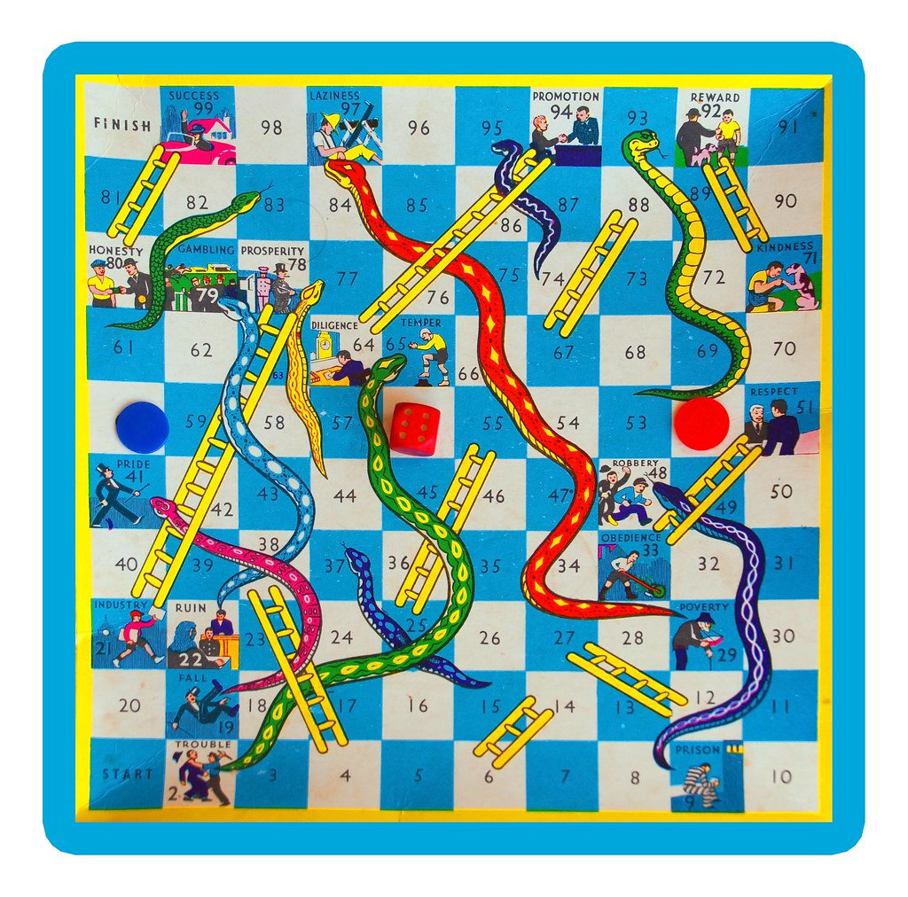
Snake and Ladder Game in C++
A Simple Implementation of a Classic Board Game Using C++
Presenters :
Awadh Kishor Singh – 2301010028
Dinkar Thakur - 2301010035
Abhishek Sharma - 2301010005

Slide 2

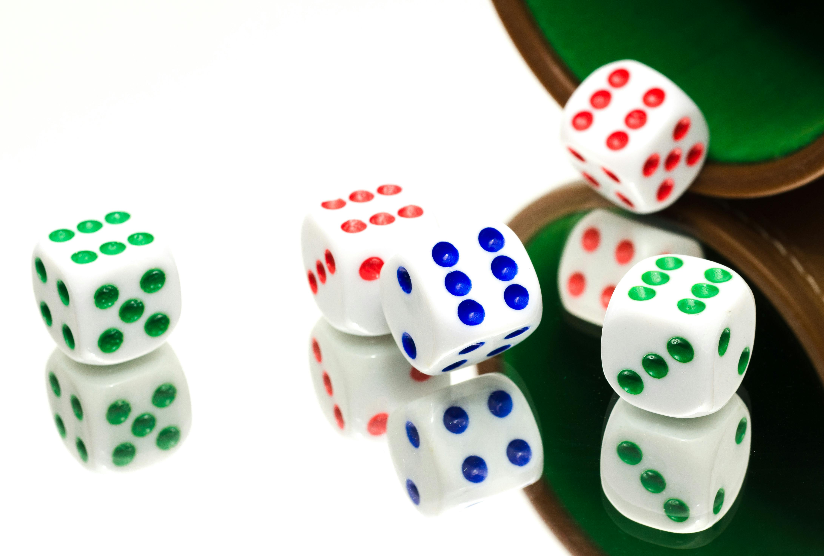
Introduction to the Game
Aim : The goal is to be the first player to reach the 100th position on the board.
Game Mechanism : Players roll a dice to move their tokens, navigating through ladders and snakes.

Slide 3
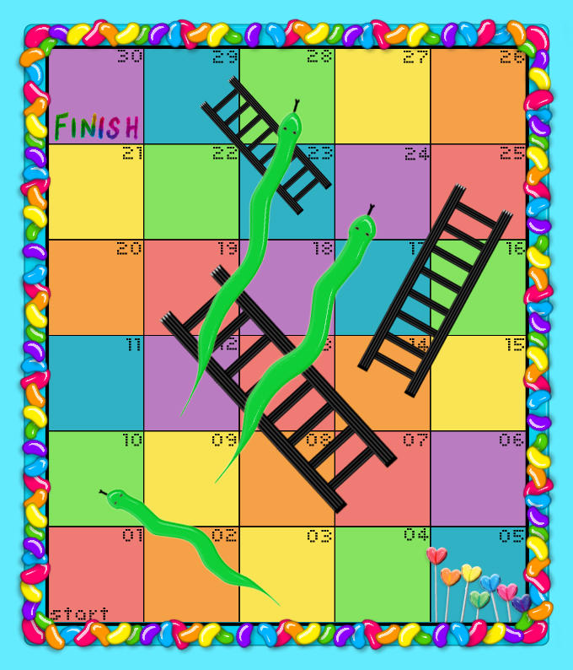
Introduction to the Game
Snake and Ladder : Landing on a ladder advances a player, while landing on a snake sends them back.

Slide 4




Attributes of the class
Name of Player 1
Name of Player 2
Position of Player 1
Position of Player 2

Slide 5
Methods of the class
Initialise_Random()
Random_Number()
Stair()

Slide 6
Methods of the class
Snake()
Print_Board()
Main()

Slide 7

Code Link :: GitHub

Slide 8


